Slide 1
Deep Learning for Extracting Adverse Drug Reactions from
User Reviews
Guided By: Sri. K. Ishthaq Ahamed
Presented By: P. Priyanka

Slide 2
Table Contents
Abstract
Base paper
Proposed model
Methodology
Model flow chart
Implementation
Results
Conclusion

Slide 3
Abstract
Adverse drug reaction are an essential part of the Analysis of drug use, drug use benefits, and making policy decisions.
Traditional methods for identifying ADRs are reliable but very slow and produce a small amount of data.
Reviews from website or in general-purpose social networks, may lead to a data source but identifying ADRs is a challenging natural language processing problem.

Slide 4
Base Paper 1
Combination of Deep Recurrent Neural Networks and Conditional Random Fields for Extracting Adverse Drug Reactions from User Reviews
Elena Tutubalina1 and Sergey Nikolenko1,2
1Kazan (Volga Region) Federal University, Kazan, Russia
2Steklov Institute of Mathematics, St. Petersburg, Russia
Received 14 April 2017; Accepted 27 July 2017; Published 5 September 2017

Slide 5
Base Paper 2
Drug-Drug Interaction Extraction via Convolutional
Neural Networks
Key Laboratory of Network Oriented Intelligent Computation, Harbin Institute of Technology Shenzhen Graduate School,
Shenzhen 518055, China
Correspondence should be addressed to Qingcai Chen; qingcai.chen@gmail.com
Shengyu Liu, Buzhou Tang, Qingcai Chen, and XiaolongWang
Received 11 October 2015; Accepted 21 December 2015

Slide 6
Proposed model
CNN for ADRs from DDI
Combining RNN and CRF
Using Bidirectional LSTM model

Slide 7
Methodology
Our works differs from the other working models on different aspects.
CNN Model with DDI for ADR’s
Joint model of CRF and RNN
In addition, we employ CNN to extract character level features instead of engineering of hand-crafted features
Word embeddings training on social media.
Quality analysis of extracted ADRs to demonstrate variation in ADRs across different patient groups.

Slide 8
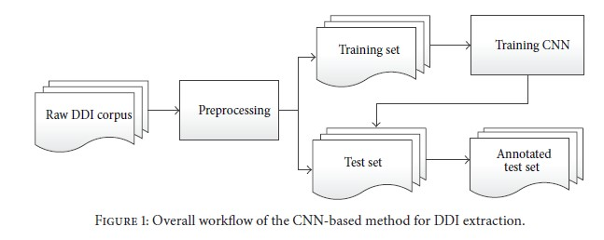
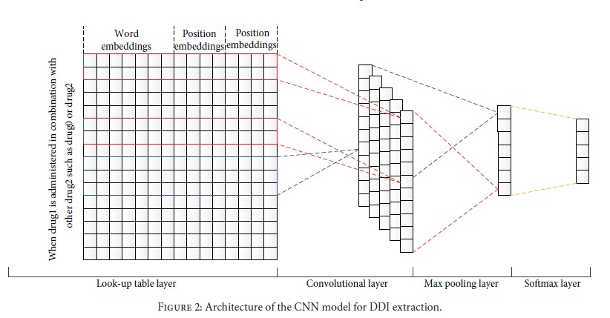
Methodology cont..,
CNN Extraction model Architecture

Slide 9
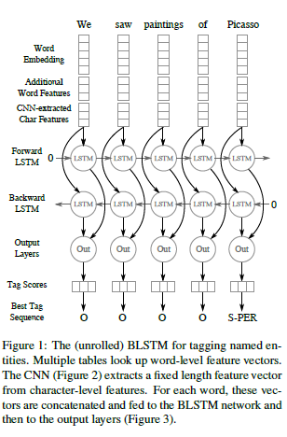
Methodology cont..,
Bi-directional LSTM model

Slide 10
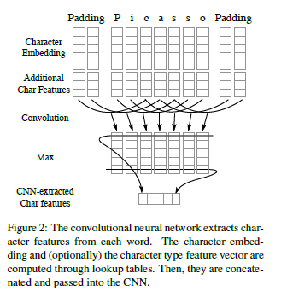
Methodology cont..,
Word Embedding model

Slide 11
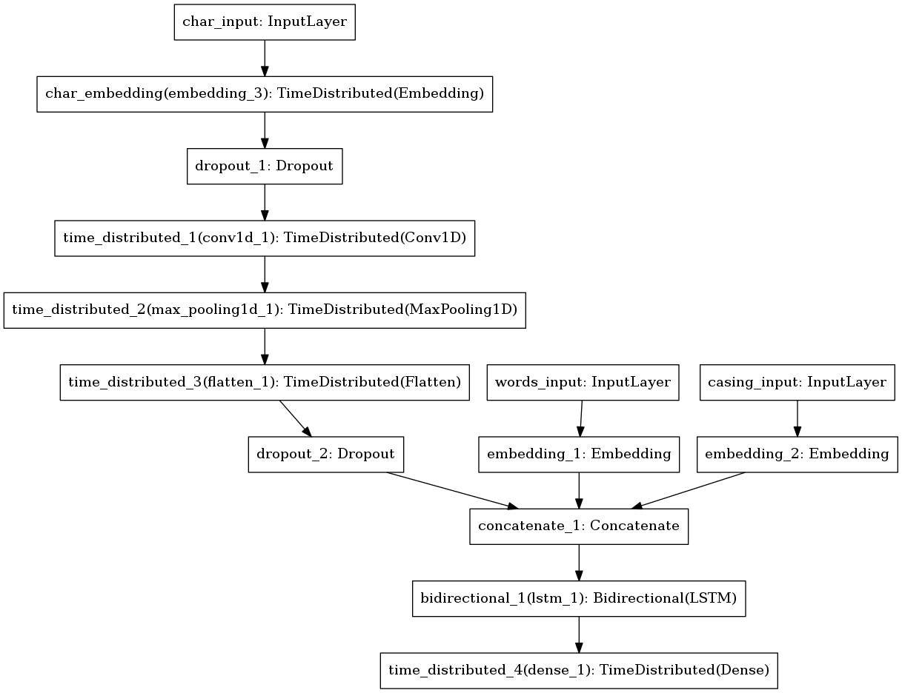
Model flow chart :

Slide 12
Dataset
Collected free text reviews of users from social media.
Example: DrugBank, MedLine.
Dataset attributes:
Brand name of the drug
Condition/reason for taking treatment
Review of the drug
Demographic information (age and gender)

Slide 13
Implementation
Extraction is the challenge, which composed of 730 DrugBank documents and 175 MedLine of DDI
Corpus is split into 2 parts a training set (572 DrugBank documents and 142MEDLINE abstracts) for system development and a test set (158 DrugBank documents and 33 MEDLINE abstracts) for system evaluation.
All drugs and pairs of drugs in each sentence are annotated.
Among the pairs of drugs (totally 33508), 5000 interacting pairs (i.e., DDIs) are classified into the following four types: mechanism, effect, advice, and int. The definitions of the four types of DDIs are as follows.

Slide 14
Implementation
Mechanism. Mechanism is assigned when pharmacokinetic mechanism of a DDI is described.
Effect. Effect is assigned when effect of a DDI is described.
Advice. Advice is assigned when a recommendation or advice regarding a DDI is given.
Int. Int is assigned when the sentence simply states that a DDI occurs and does not provide any information about the DDI.

Slide 15
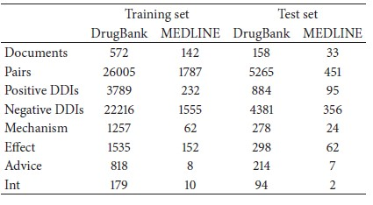
Implementation
Statistics of the DDI corpus.

Slide 16
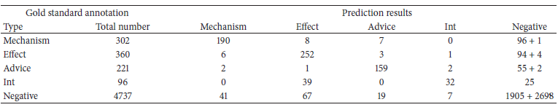
Results
Prediction Results of our CNN-based DDI extraction system.

Slide 17
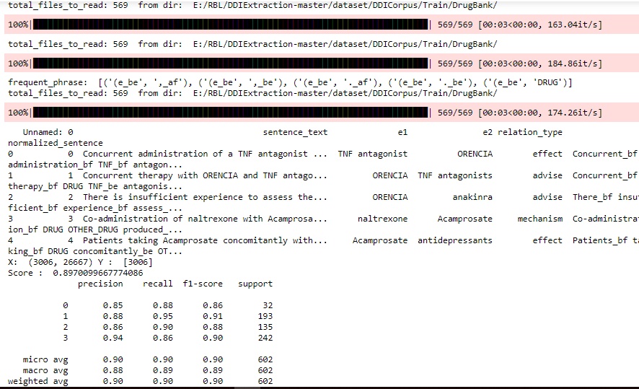
Results
DrugBank Train results

Slide 18
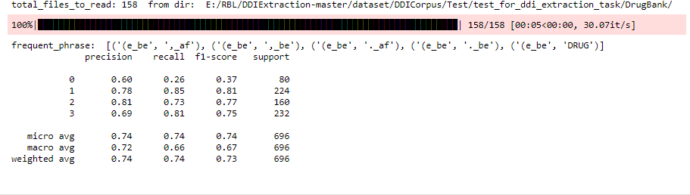
Results
DrugBank Test results

Slide 19
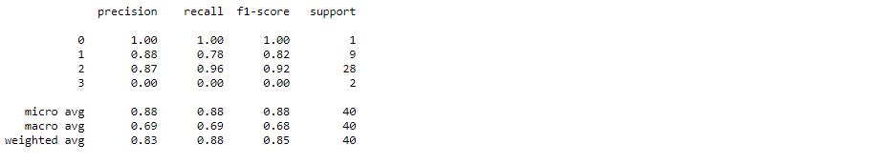
Results
MedLine Train results
MedLine Test results

Slide 20
Conclusion
We have proposed a novel approach to extract adverse drug reactions from the user reviews with DDI.
Using bidirectional LSTM –based RNN and CRF for future scope.
Using deep learning techniques in ADR extraction from free-text reviews.

Slide 21
Thank you

